Slide 1
debugging

Slide 2
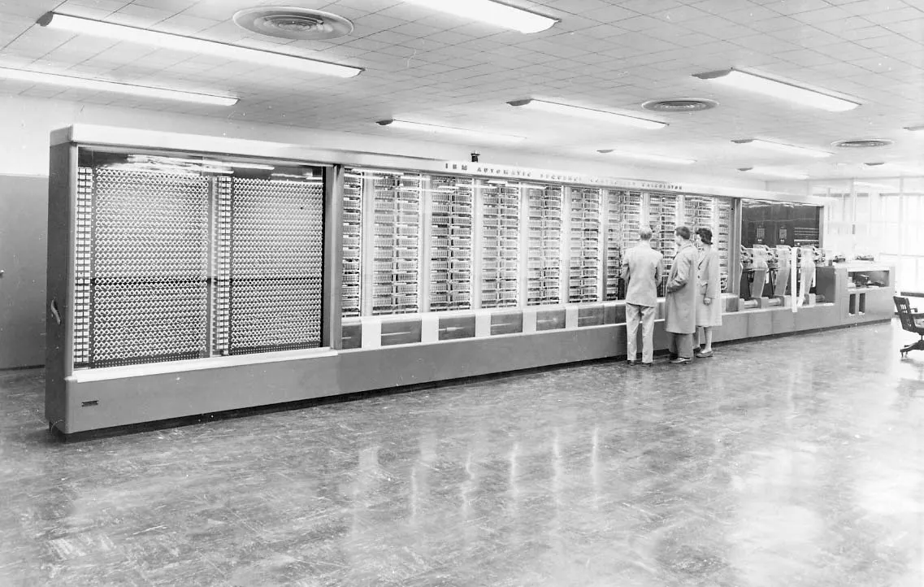

Slide 3
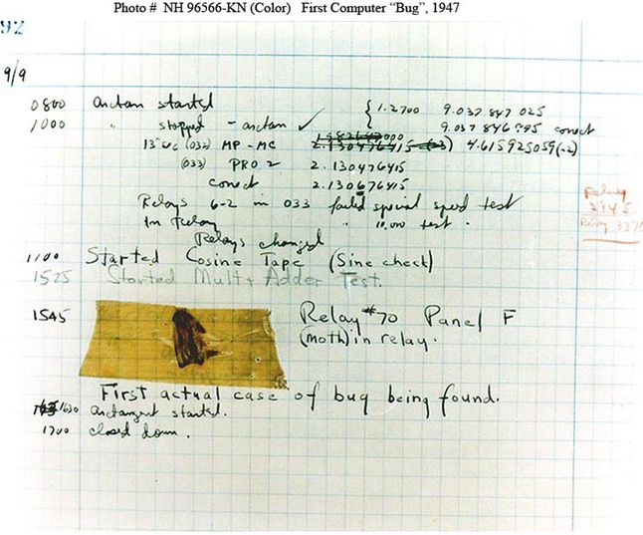

Slide 5
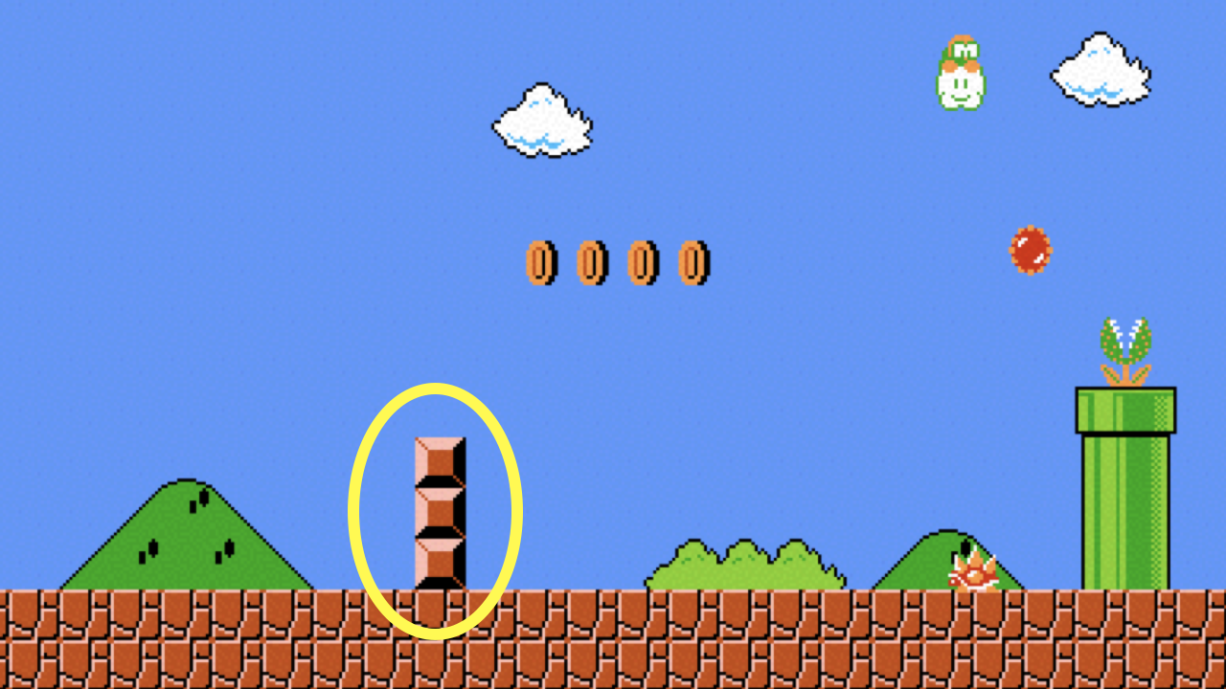

Slide 6
printf

Slide 7
printf
debug50

Slide 8
printf
debug50
rubber duck

Slide 9
rubber duck debugging

Slide 10
types

Slide 11
bool
int 32bit
long 64bit
float
double
char
string
...

Slide 12
bool 1 byte
int 4 bytes
long 8 bytes
float 4 bytes
double 8 bytes
char 1 byte
string ? bytes
...

Slide 13
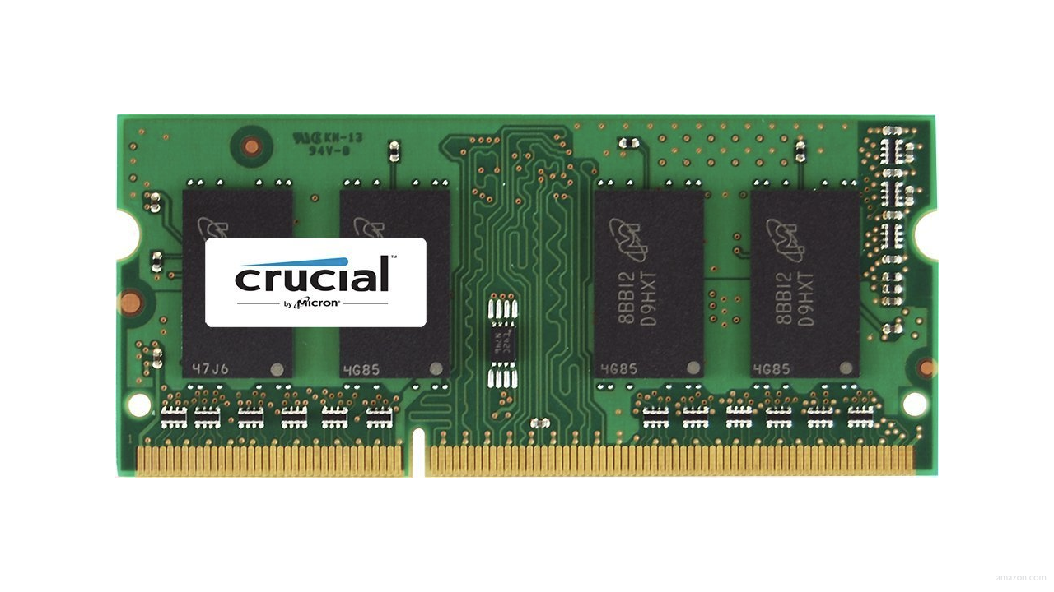

Slide 24
int score1 = 72;
int score2 = 73;
int score3 = 33;

Slide 26
72 score1

Slide 27
72 score1 |  |  |  | 73 score2

Slide 28
72 score1 |  |  |  | 73 score2
33 score3

Slide 29
00000000000000000000000001001000 score1 |  |  |  | 00000000000000000000000001001001 score2
00000000000000000000000000100001 score3

Slide 30
int score1 = 72;
int score2 = 73;
int score3 = 33;

Slide 31
arrays

Slide 32
int scores[3];

Slide 33
int scores[3];
scores[0] = 72;
scores[1] = 73;
scores[2] = 33;

Slide 34
72 scores[0] |  |  |  | 73 scores[1]
33 scores[2]

Slide 35



